Slide 1
Chicago Energy Usage
-Projecting energy usage shifts

Slide 2
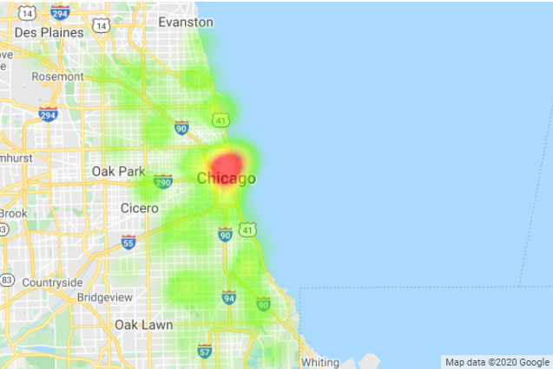
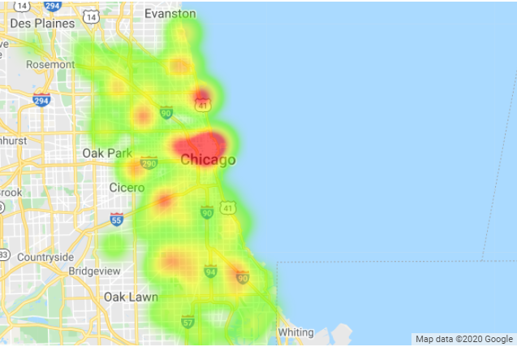
Energy Usage – 2010
Electricity
Residential ~ 4.1B KWH
Commercial ~ 7.2B KWH
Gas
Residential ~ 694M Therms
Commercial ~ 389M Therms

Slide 3
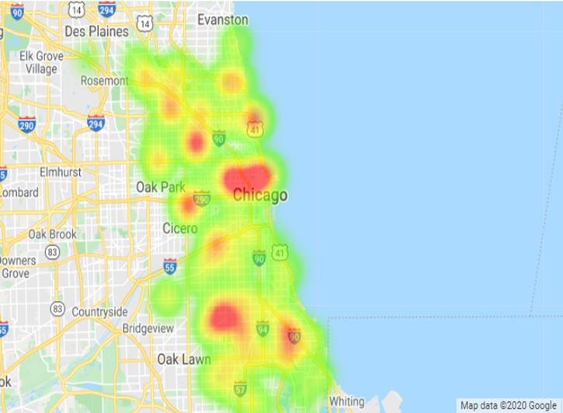
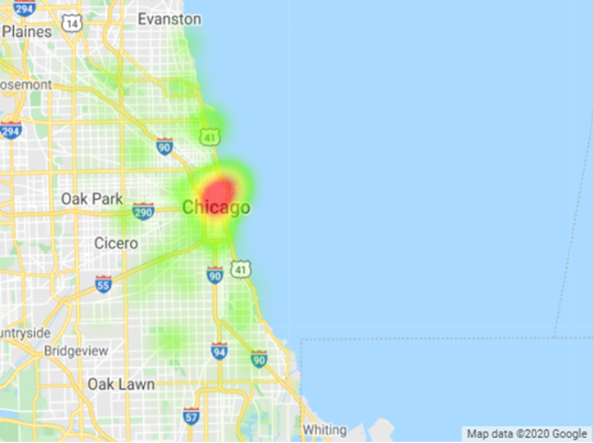
Electricity Usage – 2010
Residential Use
27% of total electricity used in Chicago
Single Family homes accounted for 57% of residential use
Commercial Use
46% of total electricity used in Chicago
The Loop accounted for 25% of commercial use

Slide 4
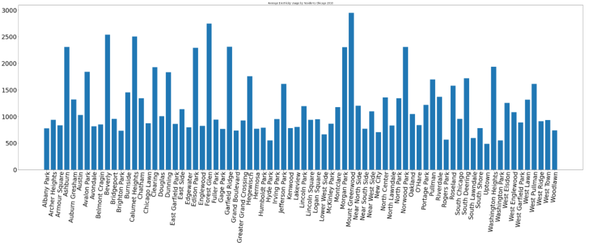
Electricity Usage – 2010
Average Electricity Usage by Residents

Slide 5
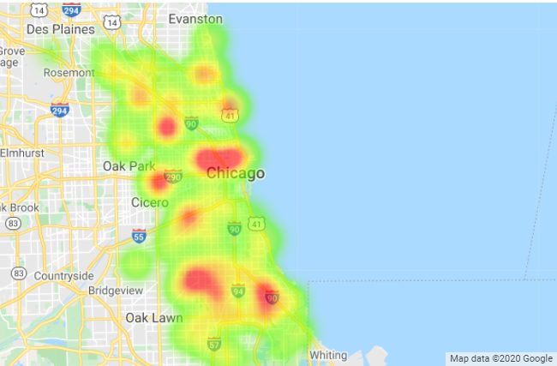
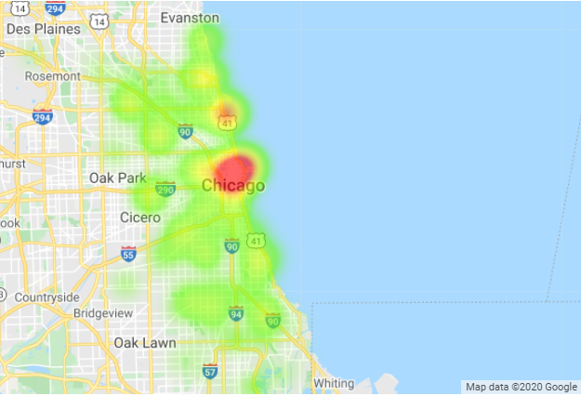
Gas Usage – 2010
Residential Use
53% of total natural gas used in Chicago
Single Family homes accounted for 52% of residential gas use
Commercial Use
30% of total natural gas used in Chicago
The Loop accounted for 10% of commercial gas use

Slide 6
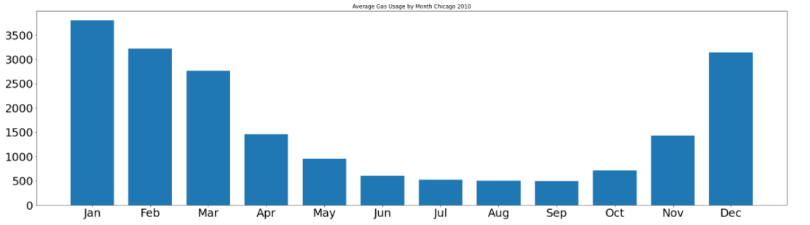
Gas Usage – 2010
Average Gas Usage by Month

Slide 7
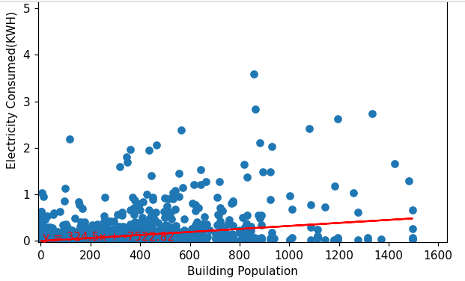
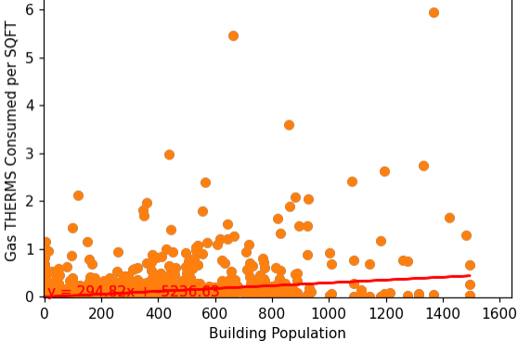
Key Stats – 2010
Building population increase is about 324 KW electricity a year across all building types
The r-squared value is: 0.1342853598783616
Building population increase is about 294 THERMS a year across all building types
The r-squared is: 0.12900909046920275

Slide 8
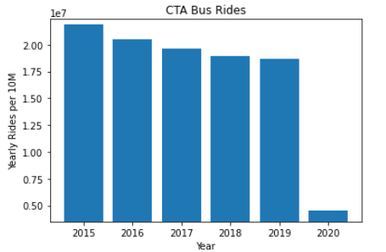
Key Stats
CTA Bus rides per year averaged 20M from 2015 to 2019
2020 is on pace to only have about 7M ~ 65% decrease

Slide 9
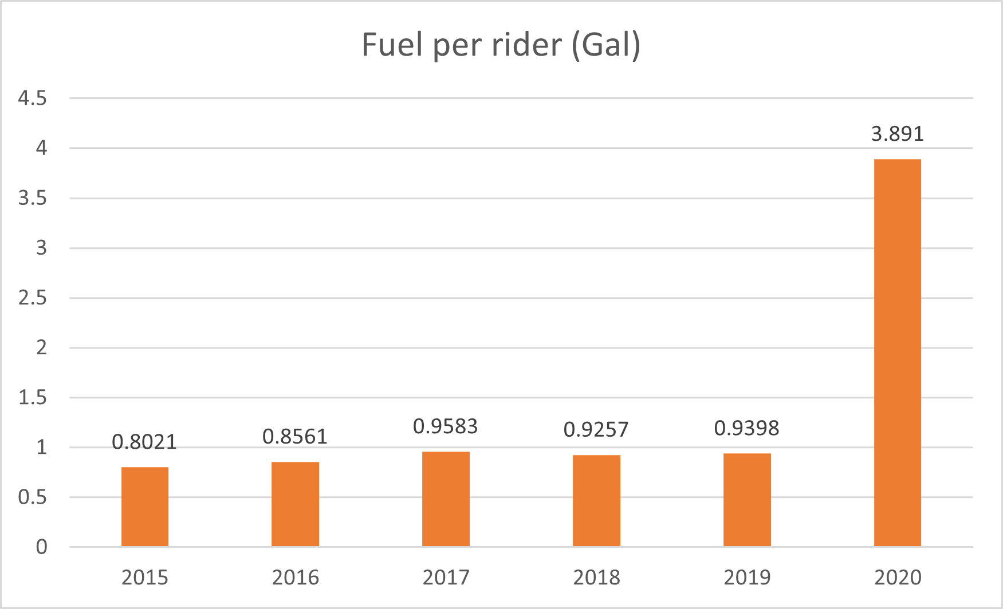
Key Stats
Fuel usage per rider for 2015-2020.

Slide 10
Energy Usage – 2020
Residential Use
Roughly 50% of people are working from home
During work from home hours, residents will use about 4 times as much energy
Commercial Use
Commercial use buildings are at about 30% capacity
CTA ridership is down by about 65-70%, but costs and energy use is only down marginally

Slide 11
Chicago Loop Construction
Chicago Loop LEED focused renovations are outpacing similar renovations in other parts of the city as non-residential real estate works to become more energy conscious.

Slide 13
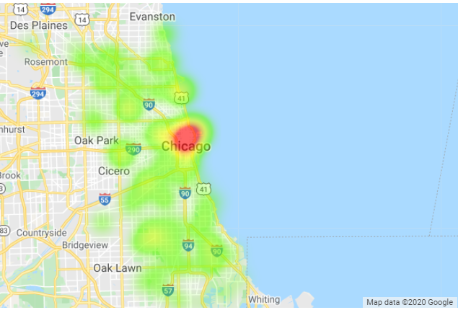
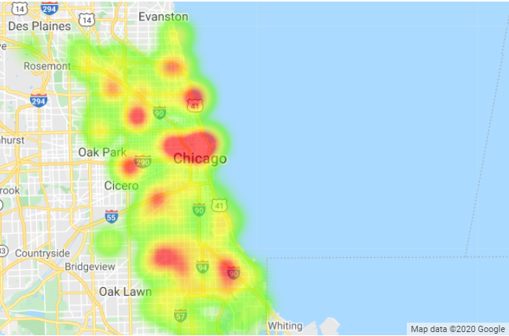
Energy Usage Projections – 2020
Electricity
Residential ~ 6.2B KWH
+2.1B KWH
Commercial ~ 6.4B KWH
-0.8B KWH
Gas
Residential ~ 972M Therms
+278M Therms
Commercial ~ 311M Therms
-78M Therms

